Slide 1
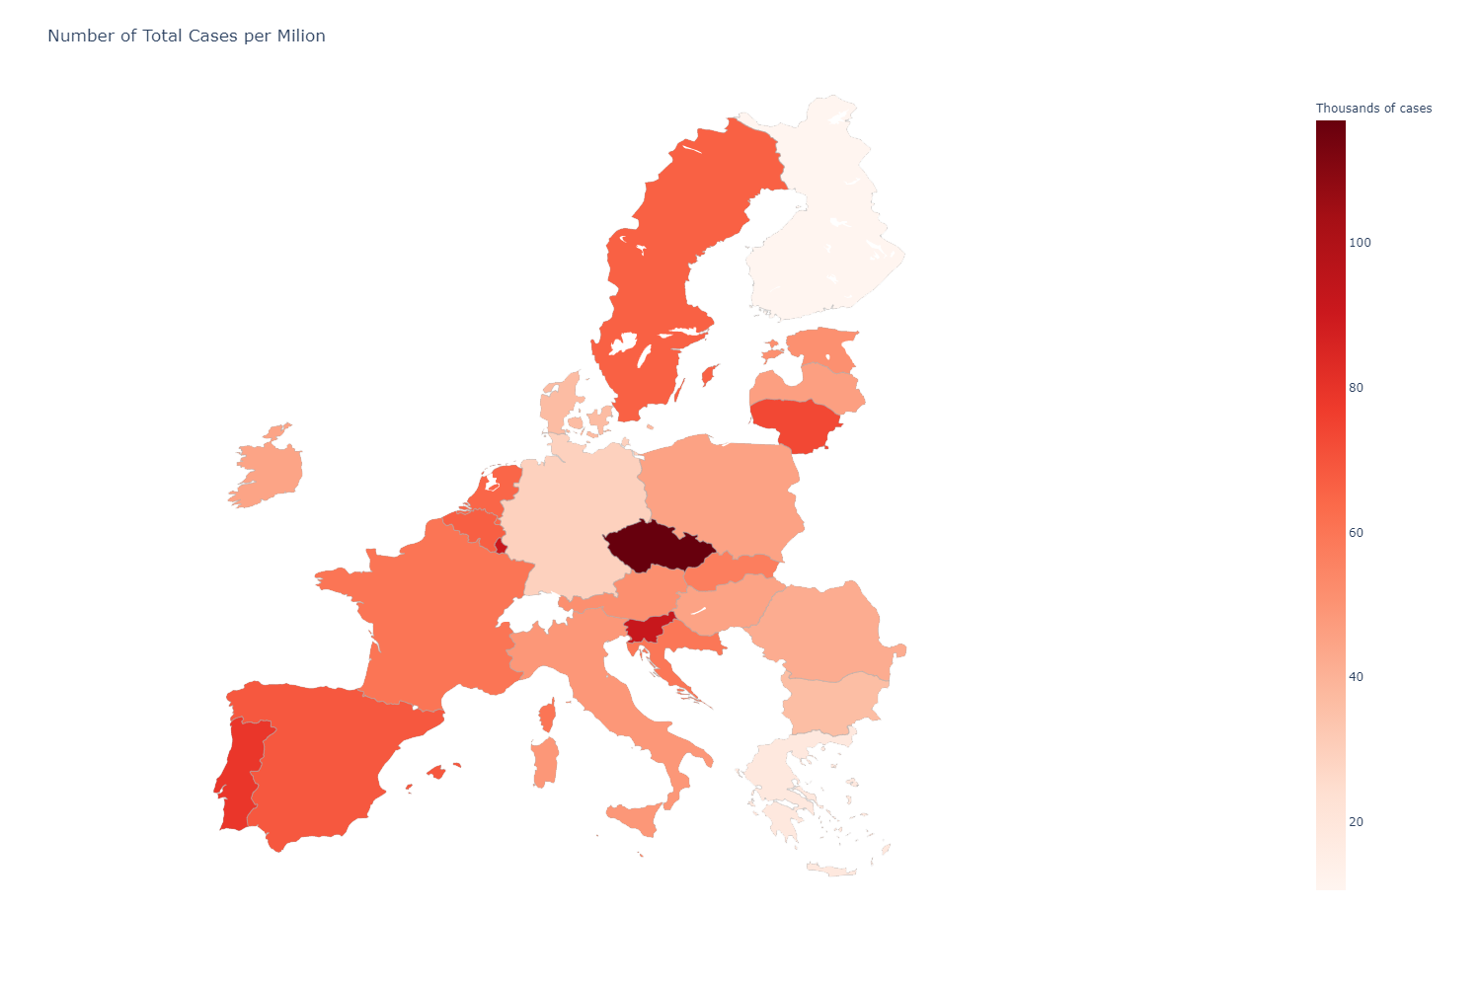
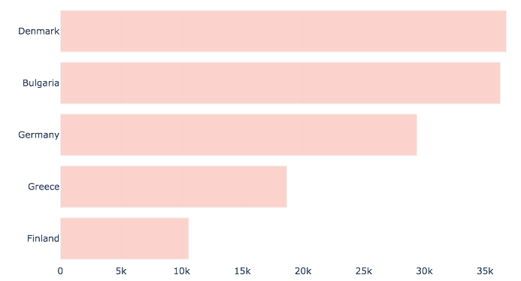
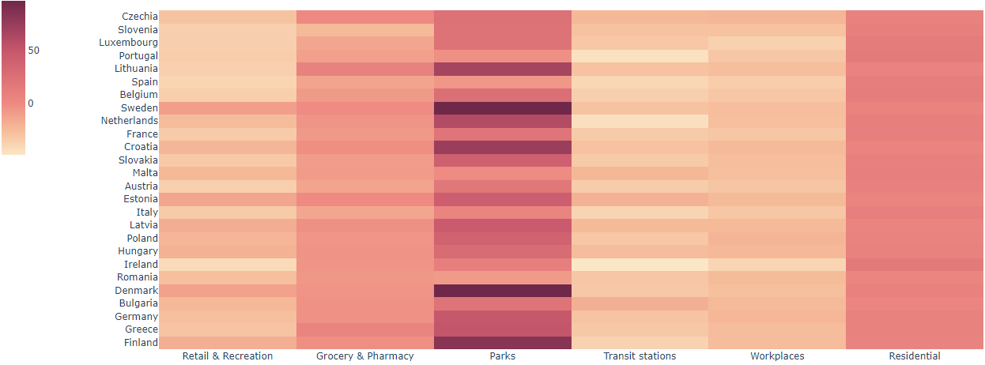

MOVING WITH COVID19
What is Covid19?
« Coronavirus disease (COVID-19) is an infectious disease caused by a newly discovered coronavirus. » - World Health Organization
.
On 31 December 2019, WHO was informed of cases of pneumonia of unknown cause in Wuhan City, China. Seven days later a novel coronavirus was identified as the cause by Chinese authorities and on 30 January 2020, WHO Director-General declared the coronavirus outbreak a public health emergency of international concern, WHO's highest level of alarm.
On 11 March 2020,more than 118 000 cases had been reported in 114 countries, and 4291 deaths had been recorded, this rapid increase in the number of cases outside China led the WHO to announce that the outbreak could be characterized as a pandemic!
New COVID-19 Cases Per Million in 2020
01 TOPICO1
TOP FIVE” BEST” COUNTRIES
TOP FIVE “WORST” COUNTRIES
GRAFICOOO
Greece
Czechia
Bulgaria
Germany
Portugal
Finland
Slovenia
Denmark
Lithuania
Luxembourg
03 TOPICO3
02 TOPICO2
bien visible…
jajaajajaj
batata
limao
hsushjgdb
jghsdghjsdgsd
olol
popop
busgjdhsdh
How did EU communities changed their mobility in 2020?
(Percent change from the baseline)
05 CONCLUSION/DISCUSSÃO
Llll
Jshjdbsmnb
Sd
Sd
Ds
S
Sd
Sd
Sd
D
D
Sas
Sd
S
sd
frahna karim 2014 © https://www.behance.net/karimfrahna
notes
Yyyyy yyyyyyyy yyyyyy yyyyyyy
Yyyyy yyyyyyyy yyyyyy yyyyyyy
Yyyyy yyyyyyyy yyyyyy yyyyyyy
Bibliographie / sources
xxxxxx-xxxxxxx-xxxxxx-xxxxxxx
xxxxxx-xxxxxxx-xxxxxx-xxxxxxx
xxxxxx-xxxxxxx-xxxxxx-xxxxxxx
Autres
email ppppp ppppp xxxxxxx
web ppppp ppppp xxxxxxx
date ppppp ppppp xxxxxxx

Slide 2
To use
01
TEXT
01
01.TEXTE
01.TEXTE
01.TEXTE
01.TEXTE
qui officia deserunt mollit anim id est laborum. Sed ut perspiciatis unde omnis iste natus error sit voluptatem accusantium dolor.
qui officia deserunt mollit anim id est laborum. Sed ut perspiciatis unde omnis iste natus error sit voluptatem accusantium dolor.
qui officia deserunt mollit anim id est laborum. Sed ut perspiciatis unde omnis iste natus error sit voluptatem accusantium dolor.
qui officia deserunt mollit anim id est laborum. Sed ut perspiciatis unde omnis iste natus error sit voluptatem accusantium dolor.
TITRE
TEXT

